Slide 1
Study and Analysis of the QubiC Quantum Control Framework
Summer Internship Progress Presentation
Guide: Dr. Nikhil Kumar CS
Presented by: Ann Mary Roy

Slide 2
Index
1. Introduction
2. Learning Roadmap
3. QubiC Architecture
4. Software Stack
5. Compiler Flow
6. Hardware Architecture
7. RF Signal Generation
8. Source Code Analysis
9. Hardware Execution
10. Calibration Workflow
11. Experimental Results
12. Advanced Features
13. Current Understanding
14. Future Work

Slide 3
SECTION 1 — INTRODUCTION

Slide 4
Internship Objective
Objectives:
Understand QubiC architecture
Study compiler flow
Analyze RFSoC execution
Execute simulation examples
Perform hardware demonstrations
Understand calibration workflows
Analyze source code modules
Expected Outcome:: End-to-end understanding of superconducting qubit control using RFSoC.

Slide 5
QubiC Overview
QubiC: An Open-Source FPGA-Based Control and Measurement System for Superconducting Quantum Information Processors
Quantum Program
↓
Compiler
↓
IR
↓
Assembler
↓
Pulse Generation
↓
RFSoC
↓
Quantum Processor
↓
Readout & Calibration

Slide 6
Why Quantum Control?
Classical Computer ↓ FPGA Controller ↓ Quantum Processor
Challenge
Quantum processors require:
Nanosecond timing
Low latency
Real-time feedback
Scalable control
Traditional CPUs cannot satisfy these requirements.
Solution : FPGA-based quantum control.
Classical CPU | FPGA
High latency | ns latency
Sequential | Parallel
Limited feedback | Real-time feedback

Slide 7
What is QubiC?
QubiC is an open-source quantum control framework.
QubiC Components
• Compiler
• Assembler
• RFSoC runtime
• Calibration framework
• Hardware abstraction layer

Slide 8
SECTION 2 — LEARNING ROADMAP

Slide 9
My Internship Learning Path
Week 1 Documentation Week 2 Simulation Examples
Week 3 Pulse Generation
Week 4 Hardware Demo
Week 5 Calibration
Week 6 Source Code Analysis
Week 7 Advanced Features

Slide 10
Documentation and Resources
Resource Contribution
QubiC Documentation Tutorials, APIs, notebooks
QubiC Paper (IEEE TQE 2021) Open-source FPGA-based control system
QubiC 2.0 Paper RFSoC implementation and distributed processing
RF Mixing Module Paper Upconversion/downconversion design
HardwareDemo Notebook Hardware execution workflow
Calibration Notebooks Rabi, Ramsey, Chevron experiments

Slide 11
Practical Work Completed
Task Status
QubiC Installation ✓
Part1 Notebook ✓
HardwareDemo ✓
Calibration Notebook ✓
Advanced Features ✓
Source Code Analysis ✓

Slide 12
SECTION 3 — SOFTWARE STACK & EXECUTION FLOW

Slide 13
QubiC Software Stack
OpenQASM ↓ High Level Program ↓ Compiler ↓ IR ↓ Assembler ↓ Binary Instructions ↓ RFSoC ↓ Qubit

Slide 14
OpenQASM Programming
reset q[0];
x q[0];
measure q[0];
Learned
Quantum gates
Delays
Loops
Measurement

Slide 15
QubiC Intermediate Representation
Why Needed?
Acts as bridge:
High-Level Program
↓
Hardware Instructions
Features:
Pulse operations
Loops
Branches
Arithmetic

Slide 16
Compiler Flow
run_compile_stage()
run_assemble_stage() Input: OpenQASM
Output: Assembly

Slide 17
Assembly Generation
Instruction Types
pulse_write_trig
pulse_write
reg_alu
jump_cond
jump_fproc

Slide 18
SECTION 4 — HARDWARE ARCHITECTURE

Slide 19
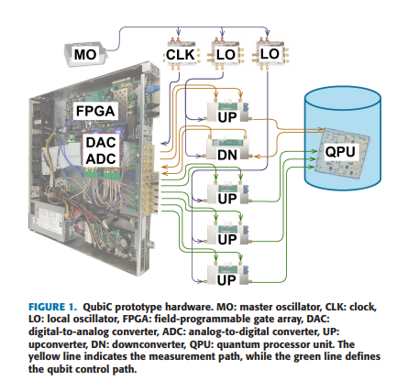
QubiC Hardware Architecture
Host PC ↓ FPGA ↓ DAC ↓ RF Mixer ↓ Quantum Processor ↓ ADC ↓ Host PC

Slide 20
QubiC Hardware Architecture
QubiC provides a complete hardware platform for control and readout of superconducting qubits. Major Components
FPGA – Executes compiled instructions and controls pulse generation.
DAC/ADC – Convert digital signals to analog RF signals and vice versa.
UP (Upconverter) – Generates RF control pulses for qubit manipulation.
DN (Downconverter) – Processes measurement signals from qubits.
LO (Local Oscillator) – Provides reference frequencies for frequency conversion.
MO (Master Oscillator) – Ensures synchronization across the system.
QPU (Quantum Processing Unit) – Contains superconducting qubits.

Slide 21
QubiC Hardware Architecture
Qubit control path
FPGA → DAC → Upconverter → QPU
Measurement path
QPU → Downconverte r → ADC → FPGA
Compiler Output
↓
FPGA
↓
DAC
↓
Upconverter
↓
QPU
↓
Downconverter
↓
ADC
↓
Measurement Result

Slide 22
Evolution of QubiC
QubiC 1.0
From the IEEE paper: FPGA-based open-source control system using VC707 FPGA + FMC120 ADC/DAC boards.
VC707 FPGA
FMC120 ADC/DAC
RF Mixing Modules
Local Oscillator System

Slide 23
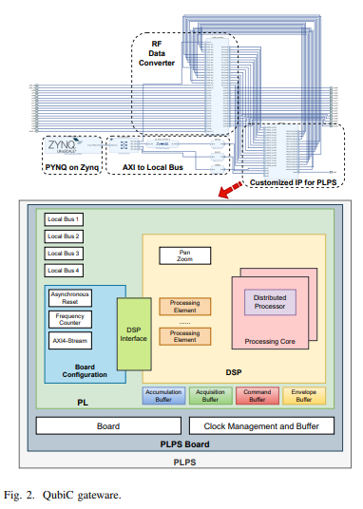
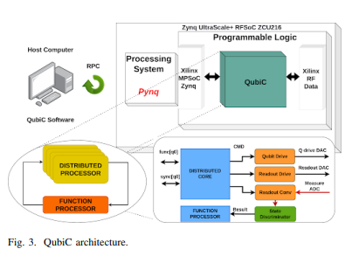
Evolution of QubiC
QubiC 2.0
From QubiC 2.0 paper.
Xilinx ZCU216 RFSoC
Integrated DAC/ADC
Distributed Processor
Mid-Circuit Measurement
Feed Forward
Multi-FPGA Synchronization

Slide 24
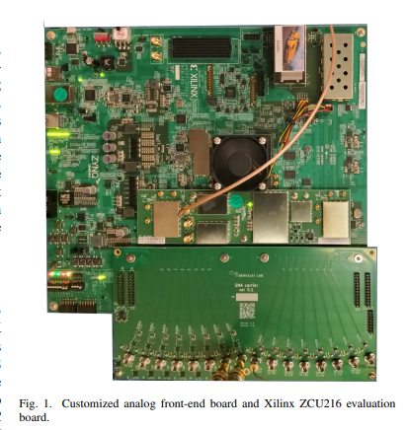
Why RFSoC?
Traditional FPGA + ADC/DAC RFSoC
Multiple boards Single chip
Higher latency Lower latency
More cables Integrated solution
Difficult synchronization Easier synchronization
Larger footprint Compact
QubiC 2.0 migrated to the Xilinx ZCU216 RFSoC platform to achieve integrated high-speed DAC/ADC functionality, reduced latency, improved synchronization, and support for real-time quantum feedback.

Slide 25
FPGA Gateware Architecture
PYNQ
AXI Interconnect
DSP Blocks
RF Data Converter
Distributed Processor

Slide 26
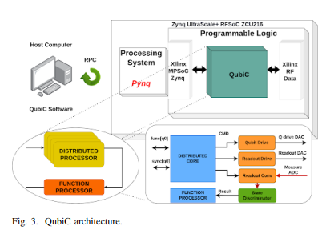
Distributed Processor Architecture
One processor per qubit
Parallel execution
Real-time branching
Feed-forward capability

Slide 27
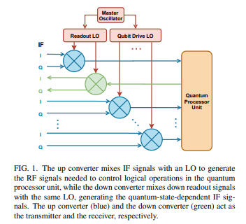
RF Signal Generation Chain

Slide 28
SECTION 5 — SOURCE CODE ANALYSIS

Slide 29
Source Code Analysis Overview
To understand how QubiC converts a quantum program into executable instructions and communicates with the RFSoC hardware.
Modules Studied
Module Purpose
toolchain.py Compilation pipeline
pulse_factory.py Pulse generation
rpc_client.py Host-to-hardware communication
soc_rpc_server.py RFSoC server execution
OpenQASM
↓
toolchain.py
↓
Assembly
↓
pulse_factory.py
↓
rpc_client.py
↓
soc_rpc_server.py
↓
RFSoC Hardware

Slide 30
toolchain.py
Purpose: Core compilation module responsible for transforming OpenQASM programs into executable assembly instructions.
Functions Studied: run_compile_stage() run_assemble_stage() compile_program()
Key Learning
Compiler workflow
Program scheduling
Instruction generation
Hardware abstraction
Compilation Pipeline
OpenQASM
↓
Parsing
↓
IR Generation
↓
Scheduling
↓
Assembly Generation

Slide 31
Assembly Instruction Generation
The assembler converts IR operations into instructions executed by distributed processors. Function of Instructions Instruction Purpose
pulse_write Generate waveform
pulse_write_trig Trigger pulse
reg_alu Register arithmetic
jump_cond Conditional branch
jump_fproc Feedback processing
Flow
IR
↓
Assembler
↓
Assembly Program
↓
Distributed Processor

Slide 32
pulse_factory.py
Purpose : Generates waveform envelopes used for quantum control pulses.
Pulse Types Studied
Gaussian Pulse
DRAG Pulse
Square Pulse
Why Needed?
Different pulse shapes reduce gate errors and improve qubit fidelity. Key Learning
Pulse shaping directly affects quantum gate performance.
Pulse Generation Flow Gate Operation
↓
Pulse Factory
↓
Waveform Samples
↓
DAC Output

Slide 33
rpc_client.py
Purpose: Provides communication between the host computer and RFSoC hardware.
Functions
Upload instructions
Configure experiments
Trigger execution
Retrieve results
Key Learning
RPC enables remote control of quantum hardware.
Communication Flow Host PC
↓
RPC Client
↓
Network
↓
RFSoC

Slide 34
soc_rpc_server.py
Purpose : Runs on RFSoC and executes commands received from the host system.
Responsibilities
Receive instructions
Configure hardware
Execute experiments
Return measurements
Key Learning
This module forms the interface between software and hardware execution.
Execution Flow
RPC Request
↓
Server
↓
Hardware Execution
↓
Measurement
↓
Response

Slide 35
End-to-End Source Code Workflow
OpenQASM Program ↓ toolchain.py ↓ IR ↓ Assembly ↓ Pulse_factory.py ↓ Waveforms ↓ Rpc_client.py ↓ Soc_rpc_server.py ↓ RFSoC ↓ Qubit ↓ Measurement Result

Slide 36
SECTION 6 — CALIBRATION FRAMEWORK

Slide 37
Why Calibration?
Calibration Workflow
One Tone ↓ Punchout ↓ Chevron ↓ Rabi ↓ Ramsey ↓ DRAG ↓ RB ↓ CR ↓ CNOT
Every qubit differs.
Sequential calibration process used to tune superconducting qubits
Need to determine:
Frequency
Amplitude
Pulse width
Readout settings
Each calibration stage improves control accuracy and prepares the system for the next stage.

Slide 38
One Tone & Punchout Measurement
Determine resonator characteristics used for qubit readout.
One-Tone Measurement
Sweeps readout frequency
Identifies resonator frequency
Punchout Measurement
Sweeps readout power
Finds optimal measurement power
Output
✓ Resonator Frequency (fr) ✓ Readout Power

Slide 39
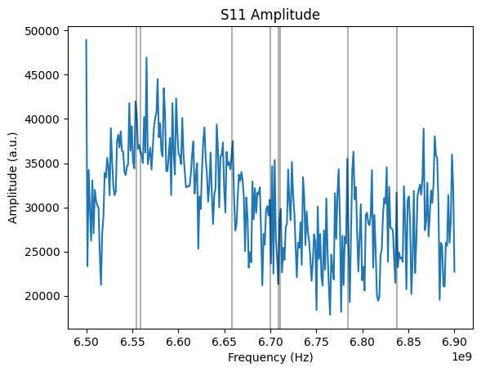
One-Tone Spectroscopy
Purpose:
Identify resonator frequencies
Determine readout resonators
Observation:
Resonance dips appear near:
Q0 ≈ 6.554 GHz
Q1 ≈ 6.558 GHz
Output:
Readout resonator frequencies extracted

Slide 40
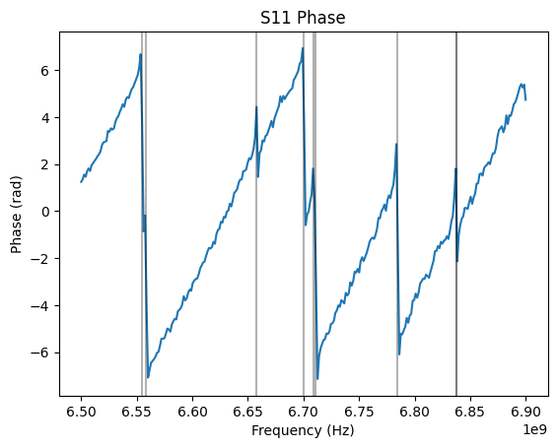
One-Tone Phase Response
Purpose:
Validate resonator locations
Observe phase transition at resonance
Observation:
Sharp phase change at resonant frequencies
Confirms resonator identification

Slide 41
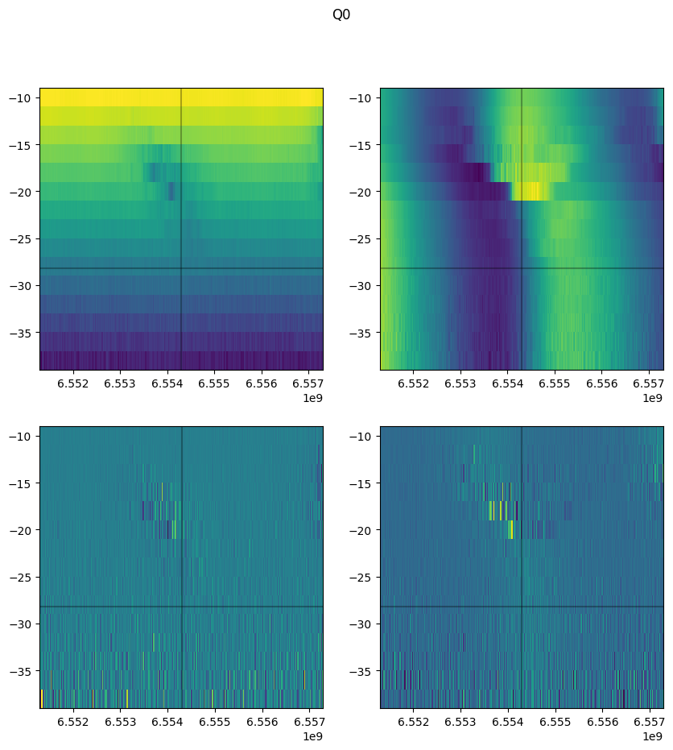
Punchout Measurement (Q0)
Purpose:
Determine optimal readout power
Study resonator behavior under varying power
Observation:
Resonator feature becomes clearly visible
Best operating region identified
Readout Frequency ≈ 6.554 GHz

Slide 42
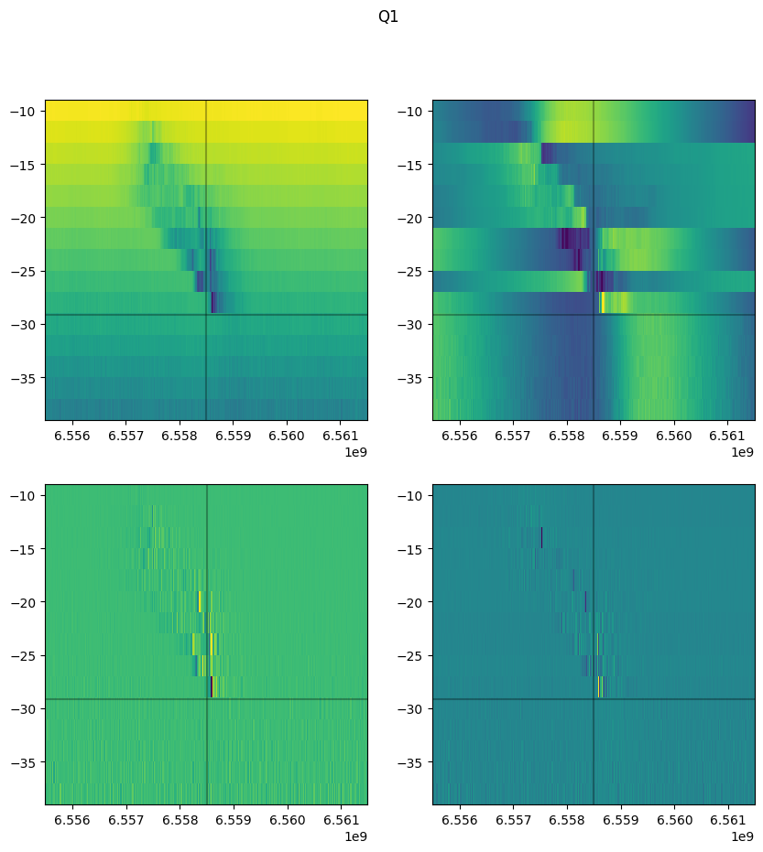
Punchout Measurement (Q1)
Purpose:
Determine Q1 resonator frequency
Optimize readout conditions
Observation:
Resonator clearly visible
Suitable power region identified
Readout Frequency ≈ 6.558 GHz

Slide 43
Results Summary
Parameter | Q0 | Q1
Resonator Frequency | ~6.554 GHz | ~6.558 GHz
Resonator Detected | Yes | Yesw
Phase Transition | Observed | Observed
Readout Region | Identified | Identified

Slide 44
Chevron Experiment
Determine the qubit transition frequency.
Method
Sweep drive frequency
Sweep pulse duration
Output: Chevron interference pattern
Parameters Extracted
Qubit frequency
Pulse timing information
X-axis → Frequency
Y-axis → Pulse duration
Color → Excited-state probability

Slide 45
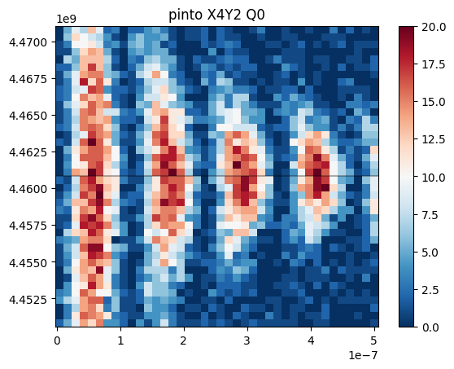
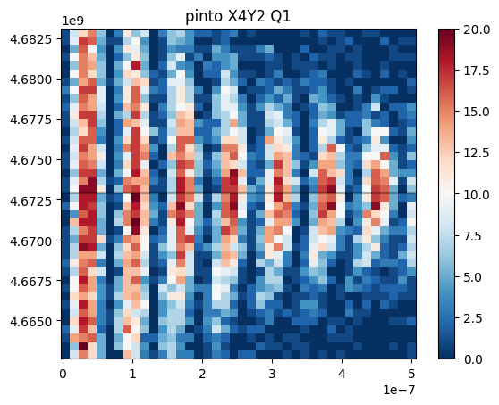
Chevron Experiment (Q0 & Q1)
Q0 Chevron
Frequency range ≈ 4.452–4.470 GHz
Clear oscillatory pattern observed
Optimal qubit frequency identified near 4.460 GHz
Q1 Chevron
Frequency range ≈ 4.663–4.683 GHz
Strong oscillation fringes observed
Optimal qubit frequency identified near 4.673 GHz

Slide 46

Rabi Calibration
Determine pulse amplitudes for quantum gates.
Procedure: Apply microwave pulse with varying amplitude.
Result
Oscillatory behavior (Rabi Oscillation)
Parameters Obtained
X90 gate amplitude
X180 gate amplitude

Slide 47
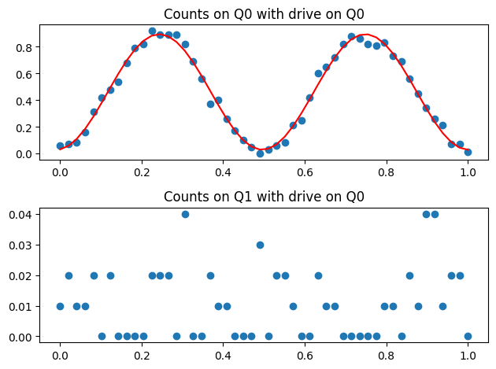
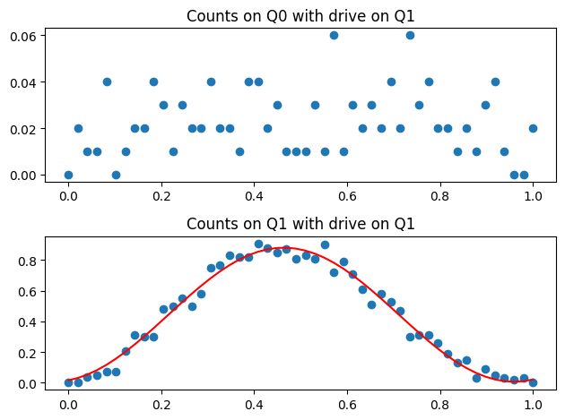
Amplitude Rabi Calibration
Clear oscillations observed for Q0 and Q1.
Oscillation maxima correspond to π pulse amplitudes.
Oscillation minima correspond to ground-state population.

Slide 48
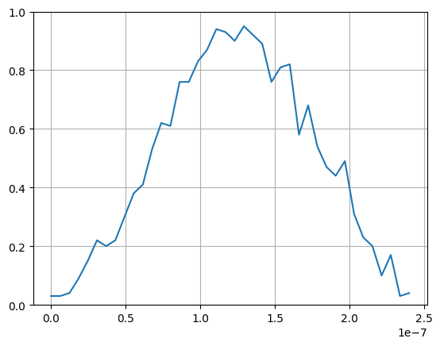
Time Rabi
Determine the pulse duration required for:
X90 gate
X180 (π pulse)
Method
Keep pulse amplitude fixed
Sweep pulse duration
Measure qubit excited-state probability
Observation
Excitation probability increases and decreases periodically
Maximum population corresponds to π pulse
Half-period corresponds to π/2 pulse

Slide 49
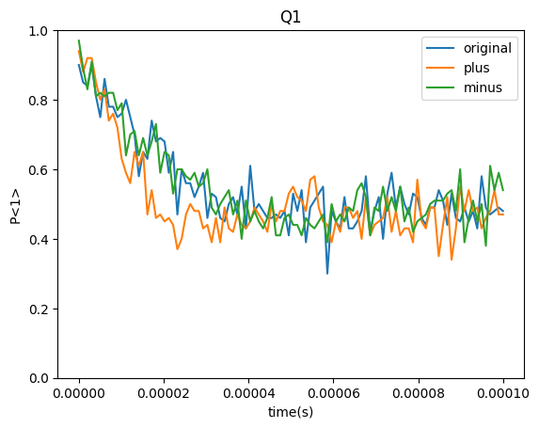
Ramsey Experiment
Ramsey Fringe Measurement
Measure qubit coherence and frequency detuning. Sequence X90 ↓ Delay ↓ X90 ↓ Measure
Parameters Obtained 1. Frequency Detuning 2. T₂* Coherence Time
Observation : Oscillation envelope decays over time.

Slide 50
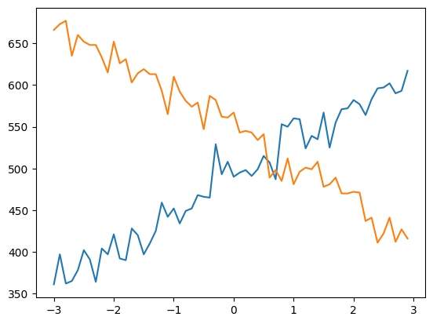
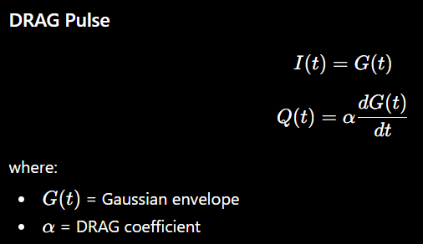
DRAG Pulse Optimization
Standard Gaussian pulses may cause leakage to higher energy states.
Solution: DRAG (Derivative Removal by Adiabatic Gate)
Benefits
Reduced leakage
Improved gate fidelity
Lower phase errors
Result: Optimized DRAG coefficient.
Two measurement curves vary oppositely with DRAG coefficient.
Optimal coefficient occurs near the crossing point.
Leakage and phase errors are minimized at this operating point.

Slide 51
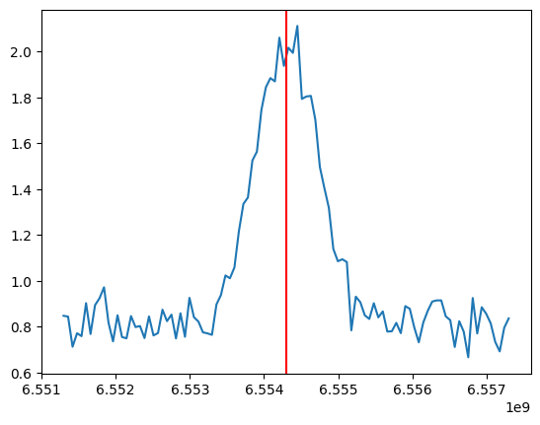
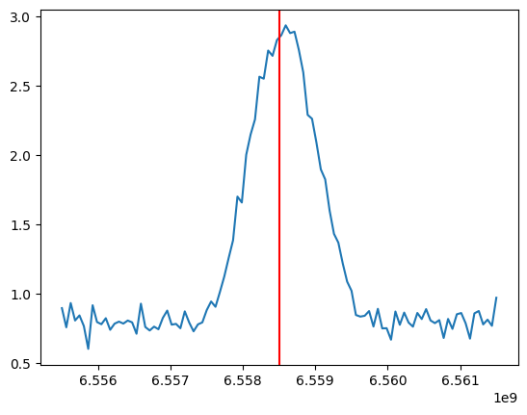
Readout Optimization
Improve discrimination between |0⟩ and |1⟩ states.
Method : Analyze IQ measurement distributions.
Parameters Optimized
Readout frequency
Readout power
Integration weights
Output: Maximum state separation.
Qubit | Readout Frequency
Q0 | ≈ 6.554 GHz
Q1 | ≈ 6.554 GHz

Slide 52
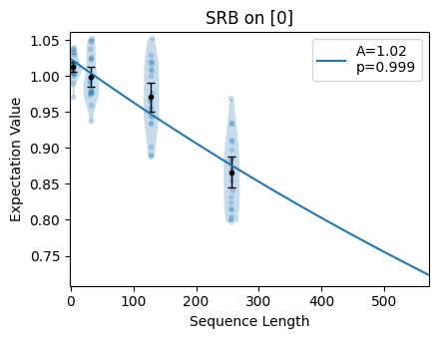
Randomized Benchmarking (RB)
Measure average gate fidelity.
Procedure: Apply random gate sequences.
Metrics
Fidelity
Error per gate
Importance : Provides realistic estimate of gate performance.

Slide 53
SECTION 7 — TWO-QUBIT OPERATIONS

Slide 54
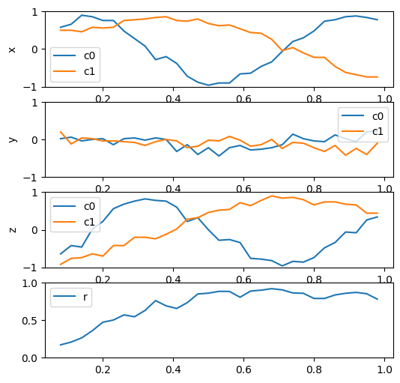
Cross Resonance (CR) Calibration
Generate entangling interaction between two qubits.
Principle: Drive control qubit at target qubit frequency.
Sweeps Performed
Pulse width sweep
Pulse amplitude sweep
Output: Optimal CR parameters.

Slide 55
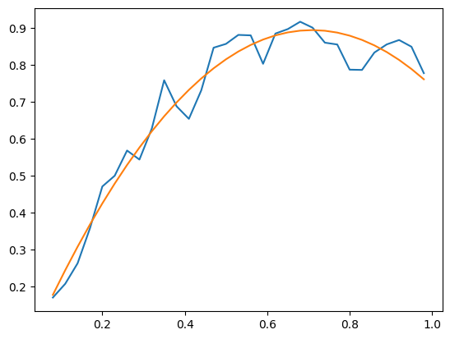
CR Amplitude Optimization
Observation:
Response increases with drive strength
Saturation region observed
Optimum operating point identified

Slide 56
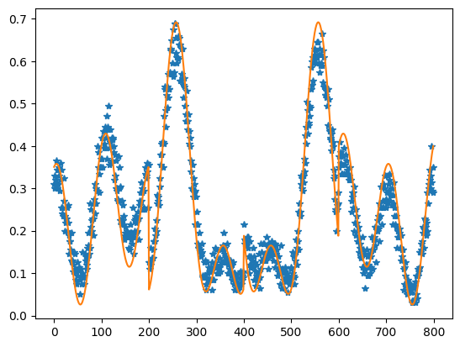
CR Hamiltonian Fit
Experimental data (blue points)
Model fit (orange curve)
Observation:
Good agreement between measurement and model
Confirms extracted interaction parameters

Slide 57
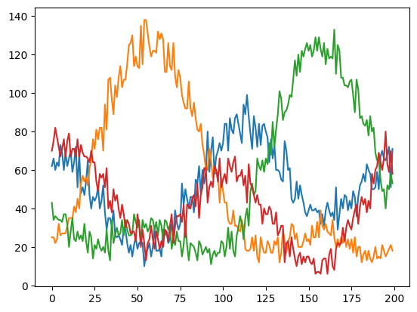
Full XY Characterization
Characterize two-qubit gate errors.
Parameters Evaluated
Phase errors
Amplitude errors
Crosstalk effects
Importance: Validates quality of entangling operations.
Observation
Distinct oscillatory behavior observed across measurement channels.
Different quadratures reveal interaction components.
Enables extraction of Hamiltonian coefficients.
Information Obtained
ZX interaction strength
IX interaction
IY interaction
Crosstalk contributions

Slide 58
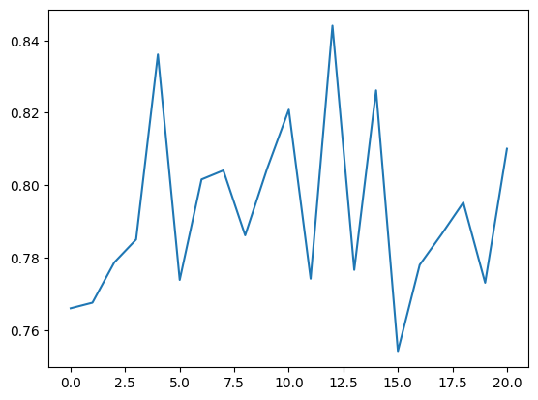
CNOT Truth Table
Verify correct operation of CNOT gate.
Ideal Truth Table
Control | Target | Output
0 | 0 | 00
0 | 1 | 01
1 | 0 | 11
1 | 1 | 10
Observation: Experimental probabilities should closely match ideal values.

Slide 59
CNOT Gate Performance Evaluation
Objective
Validate the operation of the calibrated CNOT gate.
Evaluate gate performance after CR and Full XY calibration.
Observation
Measured values remain around 0.75–0.85.
Average performance is approximately 80%.
Indicates successful implementation of the entangling gate.
Learning Outcome
Understood CNOT gate realization from CR interaction.
Evaluated two-qubit gate performance.

Slide 60
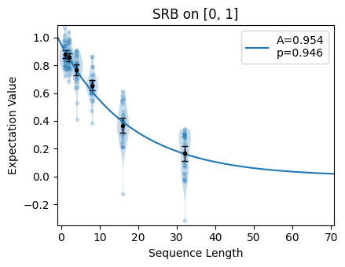
Two-Qubit Randomized Benchmarking
Measure fidelity of two-qubit gates.
Metrics
Average gate fidelity
Error rate
Importance: Most important performance metric for quantum processors.
Observation The expectation value decreases with increasing sequence length due to accumulated gate errors.
The fitted model gives:
A=0.954 p=0.946p
where:
AAA = SPAM (State Preparation and Measurement) parameter
ppp = depolarizing parameter

Slide 61
Calibration Workflow Summary
Resonator Search
↓
Punchout
↓
Readout Optimization
↓
Amplitude Rabi
↓
Time Rabi
↓
IQ Calibration
↓
Ramsey
↓
DRAG
↓
Single-Qubit RB
↓
Cross Resonance
↓
CR Calibration
↓
Full XY
↓
CNOT
↓
Two-Qubit RB

Slide 62
SECTION 8 — RECENT RESEARCH

Slide 63
Hardware-Assisted Parameterized Circuits
Parameterized quantum algorithms suffer from compilation overhead.
Idea
Store circuit template in hardware and update only parameters.
Workflow : Circuit Template
↓
Parameter Stitching
↓
FPGA Execution
Benefits
Lower latency
Faster optimization loops
Reduced compilation time

Slide 64
Relevance to QubiC
Connection to QubiC Architecture
Compiler
↓
Parameterized Circuits
↓
Distributed Processor
↓
RFSoC Execution
Why Important
Supports VQE
Supports QAOA
Enables real-time parameter updates
Learning Outcome: Understanding hardware-software co-design.

Slide 65
SECTION 9 — MY CURRENT UNDERSTANDING

Slide 66
What I Have Learned
Compiler
✓ OpenQASM
✓ IR
✓ Assembly
Hardware Execution
✓ RPC
✓ RFSoC
✓ Measurement
Calibration
✓ Single-Qubit Calibration
✓ Two-Qubit Calibration
Research
✓ Parameterized Circuits
✓ Hardware-Software Co-Design

Slide 67
Challenges Faced
Technical Challenges
OpenQASM import issues
Hardware timeout issues
Understanding compiler passes
Understanding calibration workflow
How Addressed
Documentation study
Source code analysis
Notebook experimentation
Research paper review

Slide 68
Major Achievements
✓ Installed QubiC
✓ Studied Compiler
✓ Executed Hardware Demo
✓ Performed Calibration
✓ Analyzed Source Code
✓ Investigated Advanced Features
✓ Executed 2Q Gate Characterization

Slide 69
SECTION 10 — FUTURE WORK

Slide 70
Immediate Tasks
Advanced Topics
AdvancedFeatures.ipynb
Dynamic Branching
Feed-Forward Control
Distributed Processor ISA
Next Objective
Understand real-time feedback execution inside RFSoC.

Slide 71
Towards Conference Paper
Proposed Topic: Software-Hardware Co-Design for FPGA-Based Quantum Control Using the QubiC Framework
Potential contributions:
Compiler analysis
Calibration workflow study
Parameterized circuit execution
Control-stack optimization

Slide 72
Conclusion
OpenQASM
↓
Compiler
↓
QubiC IR
↓
Assembly
↓
RFSoC Execution
↓
Measurement
↓
Calibration
↓
Validated Quantum Operations
Successfully studied and exercised the complete QubiC software stack:
Internship Outcome
✓ Architecture Understanding
✓ Source Code Analysis
✓ Calibration Execution
✓ Hardware Workflow Understanding
✓ Research Direction Identified

